Slide 1
SUMMER INTERNSHIP REPORT
Machine Learning Internship
Movie Recommendation System & House Price Prediction
Devashish Srivastava IILM University SkillInfyTech IT Solutions • 09 June 2026 – 07 July 2026 (4 Weeks)

Slide 2
Internship Overview
About the organization and the internship engagement
SIT
About SkillInfyTech
Internship Details
DOMAIN
SkillInfyTech IT Solutions is an ed-tech and IT services company under the tagline “Intern. Learn. Certify. Grow.” It runs structured, project-based internship programs across domains such as Machine Learning, giving interns real, hands-on problem statements instead of purely theoretical training.
Machine Learning
ORGANIZATION
SkillInfyTech IT Solutions
INSTITUTE
IILM University
DURATION
09 June 2026 – 07 July 2026 (4 Weeks)
MODE
Project-based, remote / CLI-driven tasks
PROJECTS COMPLETED
Movie Recommendation System, House Price Prediction
SkillInfyTech IT Solutions | Internship Report
2

Slide 3
My Role & Responsibilities
What I owned end-to-end across both ML projects
1
2
3
Data Collection & Preprocessing
Exploratory Data Analysis
Feature Engineering
Cleaned and prepared user-rating, movie-metadata and housing datasets; handled missing values and encoding.
Analyzed patterns and correlations using Pandas, NumPy, Matplotlib and Seaborn to guide model choices.
Built TF-IDF text features for content-based filtering and engineered features (area, location, rooms) for price prediction.
4
5
6
Model Development
Model Evaluation & Tuning
CLI Application & Deployment
Implemented cosine/Pearson similarity for recommendations and trained Linear Regression / XGBoost for price prediction.
Evaluated outputs and regression performance, comparing approaches to improve accuracy and relevance.
Built command-line interfaces for both systems and saved/loaded trained models using Pickle/Joblib.
SkillInfyTech IT Solutions | Internship Report
3

Slide 4
Problem Statement
Create a CLI-based movie recommendation system using collaborative filtering or content-based filtering to suggest relevant titles to users.
What It Does
Uses user rating data to suggest similar movies
Option to search by user or by movie
Content-based version uses genres and tags
Outputs the top N recommended titles via CLI
PROJECT 01
Movie
Recommendation
System
Goal
A CLI-based recommender using collaborative and content-based filtering.
To build a real-world recommender system and understand both user-based and item-based machine learning models — and to see how similarity-driven personalization works in practice.
SkillInfyTech IT Solutions | Internship Report
4

Slide 5
Project 1 — My Contribution
Movie Recommendation System — tech stack and concepts applied
My Contribution
Concepts & Skills Learned
Prepared and cleaned the movie ratings and metadata dataset
Implemented cosine similarity and Pearson correlation for user/item similarity
Built a TF-IDF based content filter using genres and tags
Designed the CLI flow for searching by user or by movie
Tested and tuned the model to return the top-N recommendations
Similarity measures (cosine, Pearson)
Matrix factorization / TF-IDF
Pandas & NumPy manipulation
Basic NLP for content-based filtering
SkillInfyTech IT Solutions | Internship Report
5

Slide 6
Problem Statement
Create a regression model to predict real estate prices based on features such as location, size, and number of rooms.
What It Does
Uses a housing dataset with features like area, location, etc.
Trains a Linear Regression or XGBoost model
CLI for predicting house price from input parameters
Supports saving and loading the trained model
PROJECT 02
House Price
Prediction
Goal
A regression model to estimate real estate prices from property features.
To explore real-world data modeling with an emphasis on regression techniques and deployment — turning a trained model into something usable via a simple CLI.
SkillInfyTech IT Solutions | Internship Report
6

Slide 7
Project 2 — My Contribution
House Price Prediction — tech stack and concepts applied
Concepts & Skills Learned
My Contribution
Feature engineering
Preprocessed and visualized the housing dataset
Engineered features from area, location and room count
Trained and compared Linear Regression and XGBoost models
Built the CLI for entering property details and getting a price estimate
Saved the trained model with Pickle/Joblib for reuse
Advanced regression models
Model persistence with Pickle/Joblib
Data visualization with Matplotlib/Seaborn
SkillInfyTech IT Solutions | Internship Report
7

Slide 8
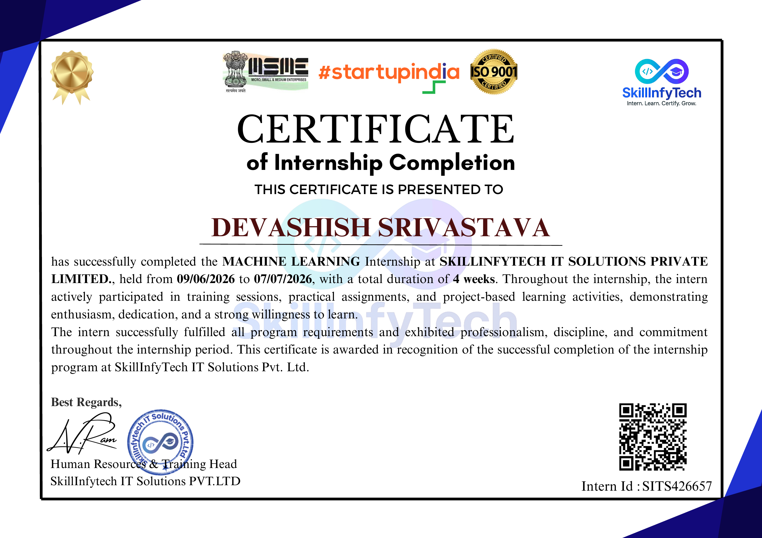
Internship Completion Certificate
Issued by SkillInfyTech IT Solutions — Intern ID: SITS426657
SkillInfyTech IT Solutions | Internship Report
8

Slide 9
Key Learnings & Conclusion
What this internship built for me
Hands-on experience with the full ML workflow — from raw data to a working CLI application
Practical fluency in Pandas, NumPy, Scikit-learn and core NLP/regression techniques
A clearer understanding of how recommendation engines and predictive models are built and evaluated
Confidence in structuring, documenting and delivering real-world project deliverables
Connect with Us
@
EMAIL
hr@skillinfytech.com
@
LINKEDIN
@skillinfytech it solutions
@
CALL
+91 9640388371
Devashish Srivastava
IILM University
Thank you

